Slide 1
IEEE Standard 754 Floating Point Numbers
The IEEE Standard for Floating-Point Arithmetic (IEEE 754) is a technical standard for floating-point computation which was established in 1985 by the Institute of Electrical and Electronics Engineers (IEEE).
IEEE Standard 754 floating point is the most common representation today for real numbers on computers, including Intel-based PC’s, Macs, and most Unix platforms

Slide 2
IEEE 754 components
The Sign of Mantissa
This is as simple as the name. 0 represents a positive number while 1 represents a negative number.
The Biased exponent :The exponent field needs to represent both positive and negative exponents. A bias is added to the actual exponent in order to get the stored exponent.
The Normalised Mantissa :The mantissa is part of a number in scientific notation or a floating-point number, consisting of its significant digits. Here we have only 2 digits, i.e. O and 1. So a normalised mantissa is one with only one 1 to the left of the decimal.

Slide 3
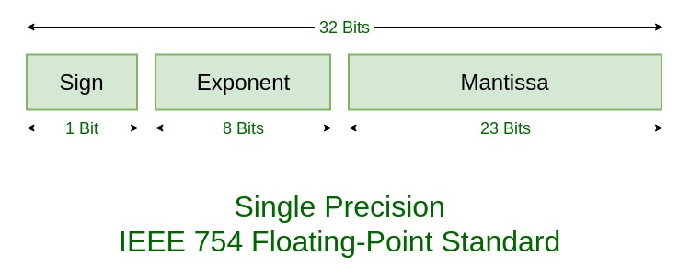
single precision

Slide 4
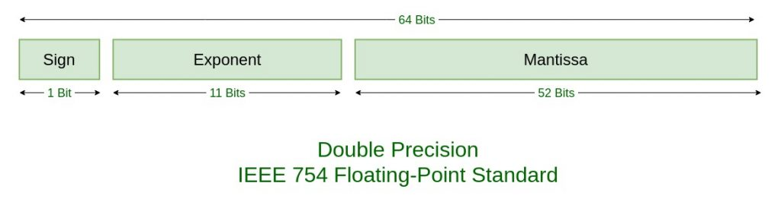
double precision

Slide 5
TYPES | SIGN | BIASED EXPONENT | NORMALISED MANTISA | BIAS
Single precision | 1(31st bit) | 8(30-23) | 23(22-0) | 127
Double precision | 1(63rd bit) | 11(62-52) | 52(51-0) | 1023

Slide 6
Example
85.125
85 = 1010101
0.125 = 001
85.125 = 1010101.001 =1.010101001 x 2⁶
sign = 0

Slide 7
1. Single precision:
biased exponent 127+6=133
133 = 10000101
Normalised mantisa = 010101001
we will add 0's to complete the 23 bits
The IEEE 754 Single precision is: =
0 10000101 01010100100000000000000
This can be written in hexadecimal form 42AA4000

Slide 8
2. Double precision:
biased exponent 1023+6=1029
1029 = 10000000101
Normalised mantisa = 010101001
we will add 0's to complete the 52 bits
The IEEE 754 Double precision is: =
0 10000000101 0101010010000000000000000000000000000000000000000000
This can be written in hexadecimal form 4055480000000000

